Slide 1
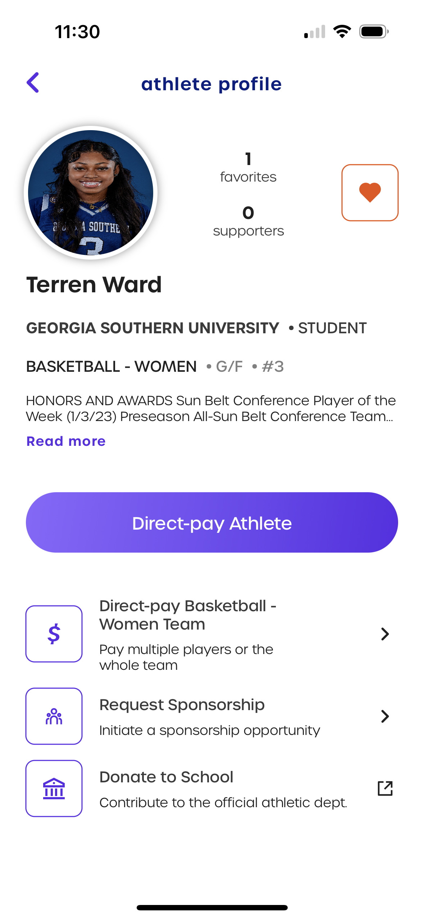
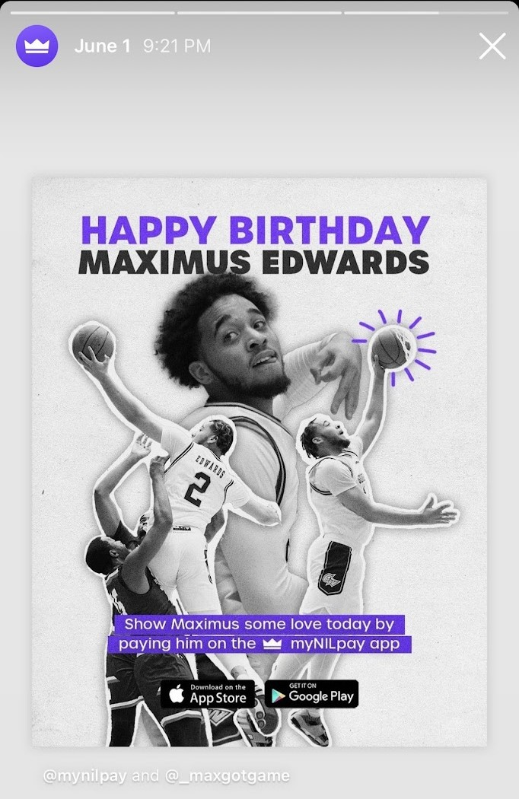
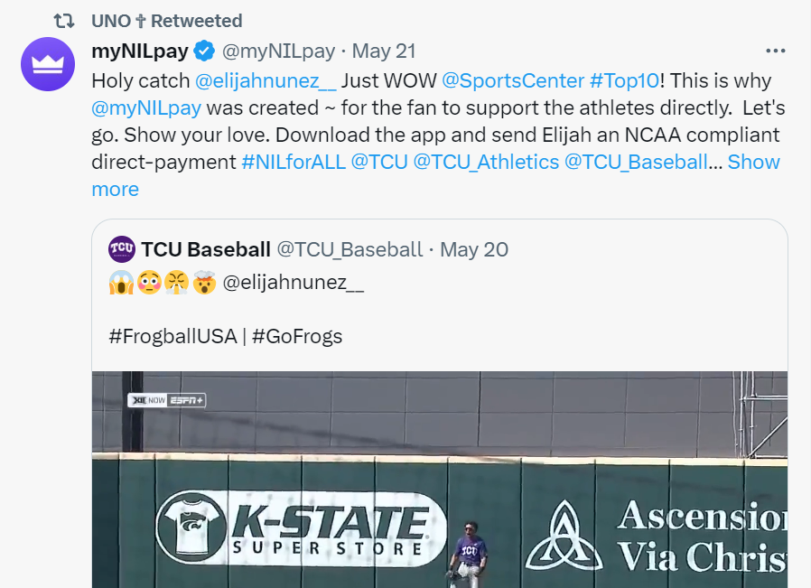
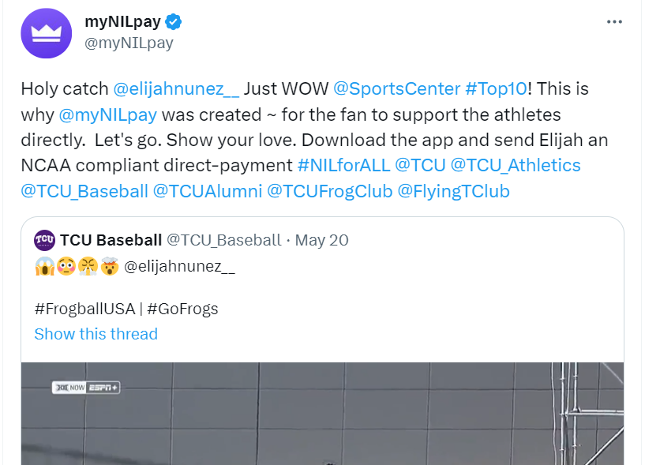
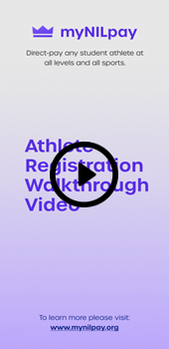
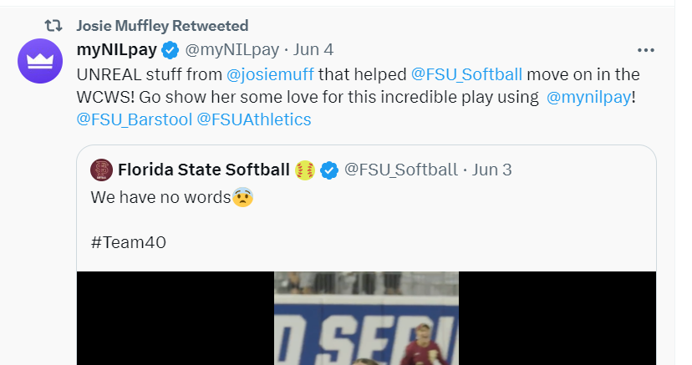
NCAA-compliant app to direct-pay student athletes
WHAT IS MYNILPAY?
myNILpay is a first-of-its-kind payment platform that allows sports fans an NCAA compliant method to direct-pay student athletes, providing an opportunity for all student athletes, men and women, revenue and non-revenue sports to monetize their Name, Image and Likeness (NIL) rights.
HOW CAN I MONETIZE MY NIL ON MYNILPAY?
Share myNILpay with your friends and family and encourage them to tell others to download the app and support you by direct-paying you.
Promote your myNILpay profile on your social media and encourage your followers to support you
Re-share posts about your achievements and ask fans to support you
Business Insider: ‘THE VENMO OF NIL’
complies with NCAA requirements
In exchange for the payment to the athlete, the fan will receive a unique digital asset featuring the athlete’s name and digital signature. By digitally signing the asset, the athlete has fulfilled the NCAA quid-pro-quo requirement and does not need to take any other action.
HOW DO I SIGN UP?
Download the myNILpay app on the Apple app store or Google Play Store
Register as an NCAA athlete
Enter your Bank Account
Begin accepting payments
Post on your socials and tag @mynilpay
Click video to watch sign-up tutorial
or visit myNILPay YouTube channel

